Slide 1
Lesson 3
CSPro CAPI Dictionary

Slide 2
Github Desktop
Clone cspro-training repository to a local folder in your computer
https://github.com/parstat/cspro-training.git
Pull the source code

Slide 3
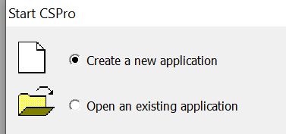
CSPro Create new CAPI applciation
Start CSPro 7.4
Choose “Create a new application”

Slide 4
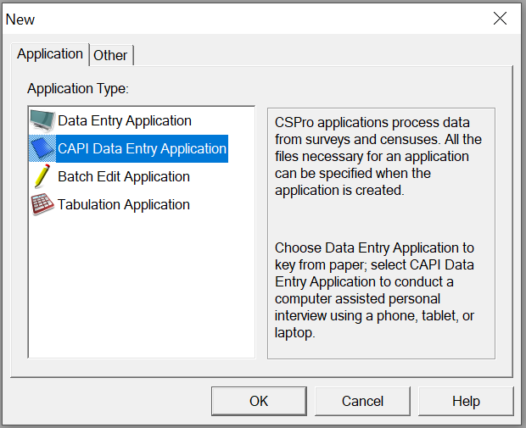
CSPro Create new CAPI application
In the “Application” tab select:
CAPI Data Entry Application

Slide 5
Data Dictionary Level
Name
Label
The name given to this level for use in the CSPro language procedures.
A descriptive text label which identifies this level.

Slide 6
Level Identification Items
Name
Start
Len
Data Type
The name given to this item for use in the CSPro language procedures
indicates the starting location of a data item
indicates the total length of the data item
specifies the type of data (numeric or alphanumeric)
Occurrence
Dec
Dec Char
Zero Fill
defines the number of consecutive repetitions of the item in the data record
specify how many digits of the numeric item represent the decimal portion of the item
states whether or not the decimal point is present in the data file
states whether the numeric data item should contain leading zeros or blanks

Slide 7
Level Records
Label
Name
Required
Max
A descriptive text label which identifies this record.
The name given to this record for use in the CSPro language procedures.
Must a questionnaire contain this kind of record? (yes|no)
The maximum number of times this type of record can appear in any one questionnaire.

Slide 8
Record Items
Name
Start
Len
Data Type
The name given to this item for use in the CSPro language procedures
indicates the starting location of a data item
indicates the total length of the data item
specifies the type of data (numeric or alphanumeric)
Occurrence
Dec
Dec Char
Zero Fill
defines the number of consecutive repetitions of the item in the data record
specify how many digits of the numeric item represent the decimal portion of the item
states whether or not the decimal point is present in the data file
states whether the numeric data item should contain leading zeros or blanks

Slide 9
Item Value Set
Label
Name
A descriptive text label for a collection of categories of an item. This is used in tabulation applications in table titles.
The name of this item for use in the CSPro language procedures

Slide 10
Value Set Values
Label
From
To
Special
Image
The descriptive text for a single value or range of values.
This is the single value, or starting value of a range associated with the value label.
This value is the upper limit of the range of values being defined. It must always be greater than the "From" value on the same line. Where only a single value is associated with the "value label," the "to" value may be blank.
A numeric data item can be assigned one of four special values in the data dictionary. These are: missing, refused, notappl, and default.
An image that is displayed along with the value label when running a CAPI application.

